Slide 1


CPEN 211 : DATABASE SYSTEM DESIGN GROUP 6 PRESENTATION

Slide 2
GROUP 6 MEMBErS
AMPONSAH JONATHAN BOADU - 11293871
Ninson Obed - 11238291
Kwarteng Andrews Twum - 11105235
Fordjour John Edward – 11254079
SENA DELASE ANYOMI - 11292620
Ahmed Fareed Opare - 11338323
Asare Marvin - 11049492
Eririe Jeffrey - 11116737
Antwi Samuel Kojo Anafi - 11164744
Daniel Akunyumu-Tetteh - 10975105

Slide 3
CONTENT
INTRODUCTION
QUERY PROCESSING
QUERRY OPTIMIZATION
CONCLUSION
REFERENCES

Slide 4
INTRODUCTION
This presentation seeks to explore the basic underlying principles involved in database query processing and optimization.
The impact of these two concepts on database design and functionality is also discussed
The presentation is aimed at providing an in-depth understanding of the processes as well as their importance in database design.

Slide 5

QUERY PROCESSING

Slide 6
WHAT IS QUERY PROCESSING?
Query Processing is a translation of high-level queries into low-level expressions.
It can be used at the physical level of the file system, query optimization, and actual execution of the query to get the result.
It requires the basic concepts of relational algebra and file structure.

Slide 7
COMPILE-Time and Runtime
Query processing consists of a compile-time phase and a runtime phase.
At compile-time, the query compiler translates the query specification into an executable program.
This query compilation is comprised of lexical, syntactical, and semantical analysis of the query specification as well as query optimization and code generation phase.

Slide 8
The code generated usually consists of physical operators for a database machine. These operators implement data access, joins, selections, scans, grouping, and aggregation.
At runtime, the database engine interprets and executes the program implementing the query specification to produce the query result.
Thus before processing a query, a computer system needs to translate the query into a machine-readable format.

Slide 9
SQL is the best suitable choice for humans. But, it is not perfectly suitable for the internal representation of the query to the system.
Relational algebra is well suited for the internal representation of a query.
A query execution engine is responsible for generating the output of the given query.

Slide 10
STEPS INVOLVED
Step-1:
Query Parsing: The database performs checks such as the following after converting the database into relational algebra:
LEXICAL ANALYSIS
SYNTAX CHECKS
SEMANTIC CHECK

Slide 11
STEPS INVOLVED
Step-2:
Optimization : It is a process in which multiple query execution plan for satisfying a query are examined and the most efficient query plan is selected for execution.
Database catalogue stores the execution plans and then optimizer passes the lowest cost plan for execution.

Slide 12
STEPS INVOLVED
Step-3:
This involves relational algebra transformation.
Step-4:
An execution plan is then generated by selecting the best suited plan.
Step-5:
The execution engine finally runs the query and display the required result.

Slide 13
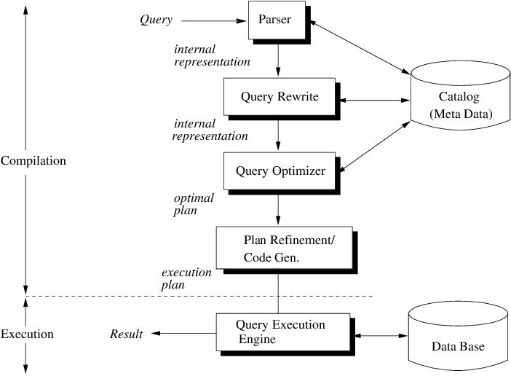

Slide 14

QUERY
OPTIMIZATION

Slide 15
WHAT IS QUERY OPTIMIZATION?
Query Optimization is the process of selecting an efficient execution plan for evaluating data.
After parsing of the query, parsed query is passed on to the query optimizer, which generates different execution plans to evaluate parsed query and selects the plan with the least estimated cost

Slide 16
IMPORTANCE OF QUERY OPTIMIZATION
Query optimization is critical because it directly impacts the performance of database systems.
Poorly optimized queries can result in slow response times and increased system resource utilization. On the other hand, well-optimized queries can lead to faster response times, reduced resource utilization, and improved user satisfaction.

Slide 17
Key Factors That Impact Query Performance
Indexing: Indexing is the process of creating data structures that enable fast retrieval of data. Queries that rely on indexed columns tend to perform much faster than queries that do not.
Joins: Joins are used to combine data from multiple tables. The complexity of the join, the size of the tables being joined, and the number of indexes on the join columns can all impact query performance.

Slide 18
Key Factors That Impact Query Performance
Data Distribution: The distribution of data across different tables can impact query performance. If data is distributed unevenly, queries may need to scan large portions of the table to retrieve the desired data.
Query Complexity: The complexity of the query itself can impact performance. Complex queries that involve many subqueries, correlated subqueries, or nested joins tend to perform more slowly than simpler queries.

Slide 19
TECHNIQUES FOR QUERY OPTIMIZATION
Indexing: As mentioned earlier, indexing is one of the most important techniques for query optimization. By creating indexes on frequently queried columns, queries can be executed more quickly.
Query Rewriting: Query rewriting involves changing the structure of the query to make it more efficient. This can include techniques such as simplifying the query, breaking it into smaller subqueries, or reordering the join operations.

Slide 20
TECHNIQUES FOR QUERY OPTIMIZATION
Partitioning: Partitioning involves dividing large tables into smaller, more manageable pieces. This can improve query performance by reducing the amount of data that needs to be scanned.
Materialized Views: Materialized views are precomputed queries that are stored in the database. By creating materialized views for frequently executed queries, query response times can be significantly improved.

Slide 21
QUERY OPTIMIZATION PROCESS
Profiling: Profiling involves analyzing the query execution plan and identifying areas where performance can be improved.
Analysis: In this step, the query is analyzed to identify potential bottlenecks and areas for improvement.

Slide 22
QUERY OPTIMIZATION PROCESS
Optimization: Optimization involves applying the techniques discussed earlier to improve query performance.
Testing: Finally, the optimized query is tested to ensure that it performs as expected and does not introduce new issues.

Slide 23
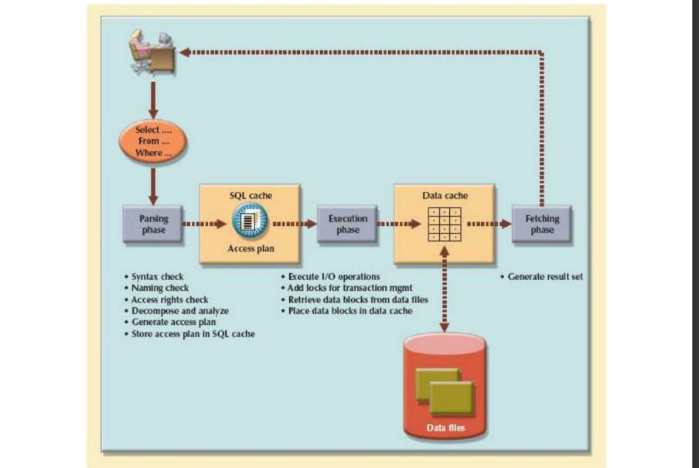

Slide 24
CONCLUSION
Query processing and optimization are critical components of database design and execution that can have a significant impact on system performance. By understanding the key factors that impact query performance and the different techniques that can be used to optimize queries, database designers can create highly efficient systems that meet the needs of their users.

Slide 25
REFERENCES
[1] Henk Ernst Blok, Djoerd Hiemstra and Sunil Choenni, Franciska de Jong, Henk M. Blanken and Peter M.G. Apers. Predicting the cost-quality trade-off for information retrieval queries: Facilitatiing database design and query optimization. Proceedings of the tenth international conference on Information and knowledge management, October 2001, Pages 207-214.
[2] D. Calvanese, G. De Giacomo, M. Lenzerini and M. Y. Vardi. Reasoning on Regular Path Queries. ACM SIGMOD Record, Vol. 32, No. 4, December 2003.
[3] Andrew Eisenberg and Jim Melton. Advancements in SQL/XML. ACM SIGMOD Record, Vol. 33, No. 3, September 2004.
[4] Andrew Eis enberg and Jim Melton. An Early Look at XQuery API for Java™ (XQJ). ACM SIGMOD Record, Vol. 33, No. 2, June 2004.
[5] Ramez Elmasri and Shamkant B. Navathe. Fundamentals of Database Systems, second edition. Addison-Wesley Publishing Company, 1994.
[6] Donald Kossmann and Konrad Stocker. Iterative Dynamic Programming: A new Class of Query Optimization Algorithms. ACM Transactions on Database Systems, Vol. 25, No. 1, March 2000, Pages 43-82.
[7] Chiang Lee, Chi-Sheng Shih and Yaw-Huei Chen. A Graph-theoritic model for optimizing queries involving methods. The VLDB Journal — The International Journal on Very Large Data Bases, Vol. 9, Issue 4, April 2001, Pages 327-343.
[8] Hsiao-Fei Liu, Ya-Hui Chang and Kun-Mao Chao. An Optimal Algorithm for Querying Tree Structures and its Applications in Bioinformatics. ACM SIGMOD Record Vol. 33, No. 2, June 2004.
[9] Reza Sadri, Carlo Zaniolo, Amir Zarkesh and Jafar Adibi. Expressing and Optimizing Sequence Queries in Database Systems. ACM Transactions on Database Systems, Vol. 29, Issue 2, June 2004, Pages 282-318. [
10] Reza Sadri, Carlo Zaniolo, Amir Zarkesh and Jafar Adibi. Optimization of Sequence Queries in Database Systems. In Proceedings of the twentieth ACM SIGMOD-SIGACTSIGART symposium on Principles of database systems, May 2001, Pages 71-81.
[11] Thomas Schwentick. XPath Query Containment. ACM SIGMOD Record, Vol. 33, No. 1, March 2004. [12] Avi Silbershatz, Hank Korth and S. Sudarshan. Database System Concepts, 4th Edition. McGraw-Hill, 2002.
[13] Dimitri Theodoratos and Wugang Xu. Constructing Search Spaces for Materialized View Selection. Proceedings of the 7th ACM international workshop on Data warehousing and OLAP, November 2004, Pages 112-121.
[14] Jingren Zhou and Kenneth A. Ross. Buffering Database Operations for Enhanced Instruction Cache Performance. Proceedings of the 2004 ACM SIGMOD international conference on Management of data, June 2004, Pages 191-202

